Slide 1
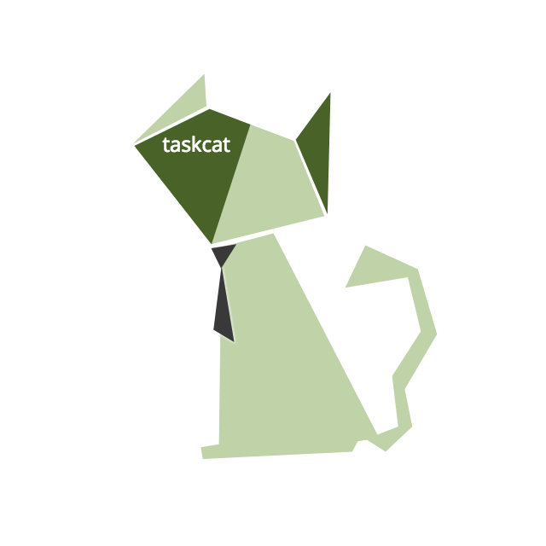
Quick Start Reference Architectures
and
CloudFormation Development Tools

Slide 2
What are Quick Starts?
Quick Starts are automated reference deployments for key workloads on the AWS Cloud.
Each Quick Start launches, configures, and runs the AWS compute, network, storage, and other services required to deploy a specific workload on AWS, using AWS best practices for security and availability.
More info: https://aws.amazon.com/quickstart/faq/

Slide 3
Where can I find Quick Starts?

Slide 4
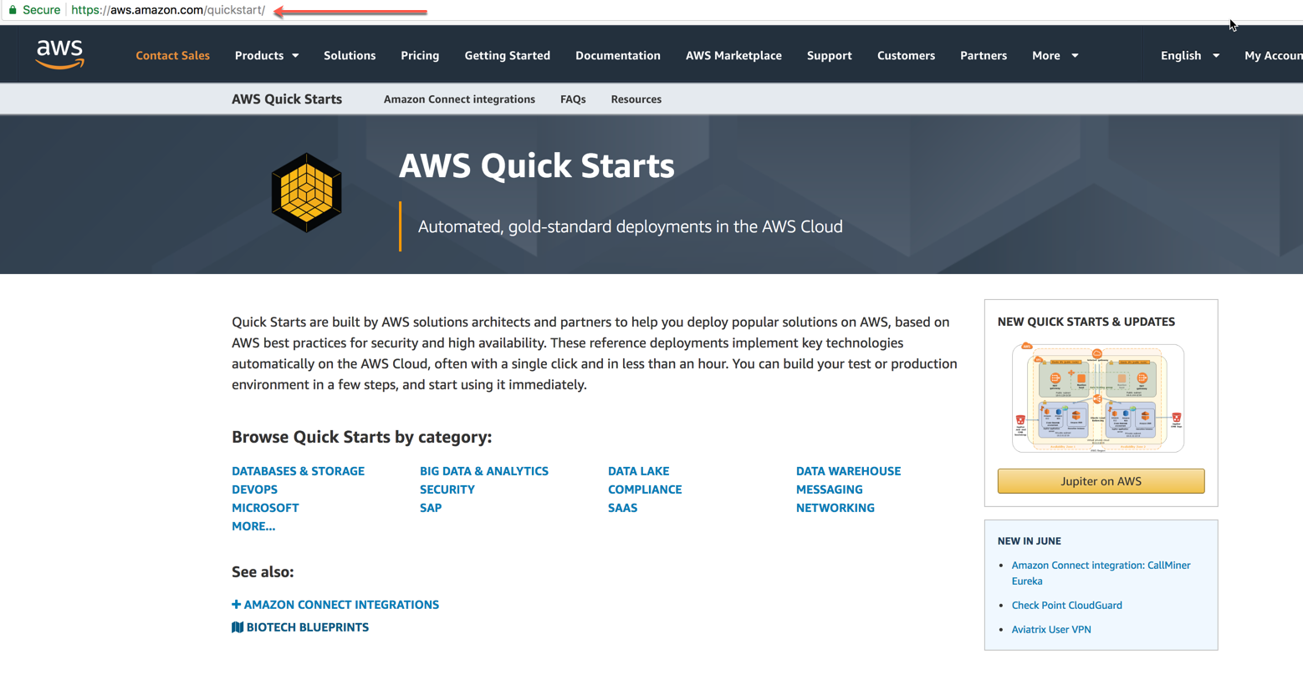
Quick Starts are published on the AWS Quick Start site
https://aws.amazon.com/quickstart

Slide 5
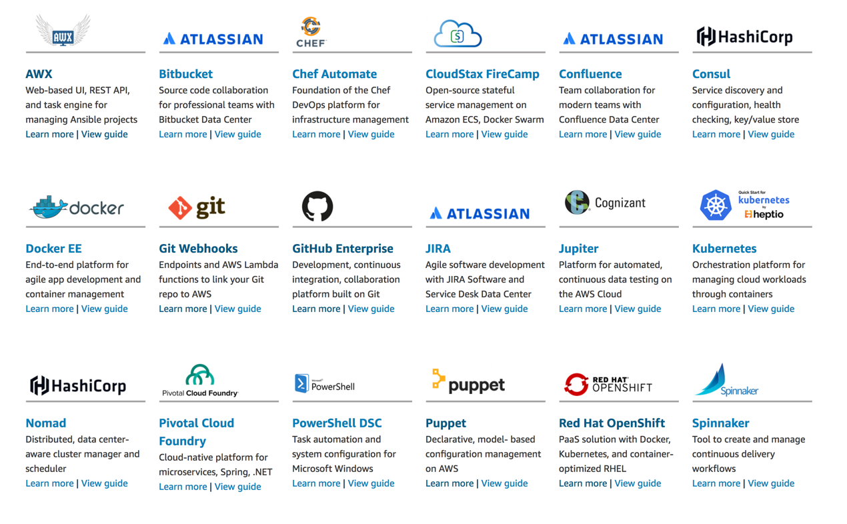
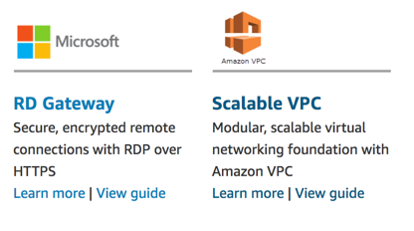
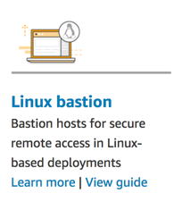
Examples of Quick Starts

Slide 6
Quick Start Concepts
Modularity
Portability

Slide 7
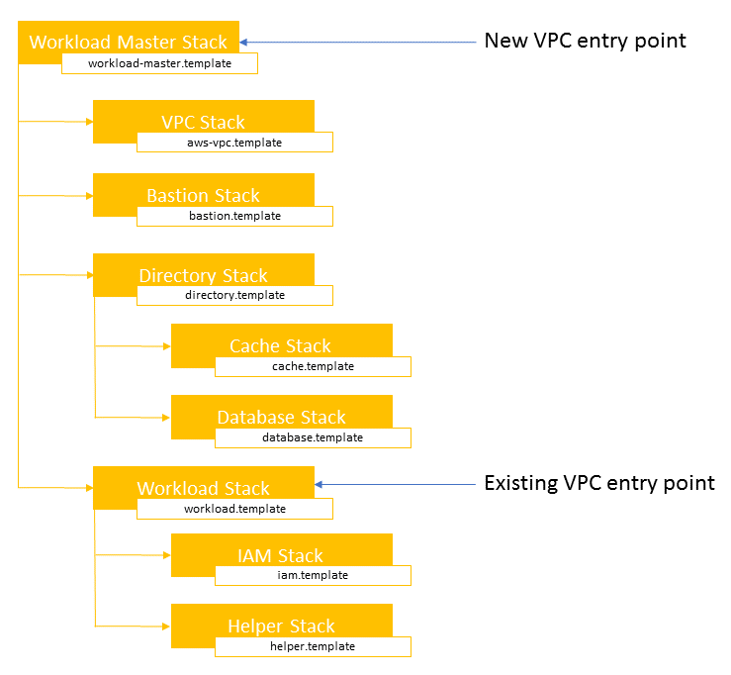
Modularity
The master template deploys one or more nested stacks, depending on the Quick Start.
One or more of those nested stacks will deploy the actual workload of the Quick Start while the others will be referenced as submodules (inside the /submodules/quickstart-repo-name folder for each referenced Quick Start in Git at a particular commit level).
This ensures that the reference is repeatable and does not change unexpectedly.

Slide 8
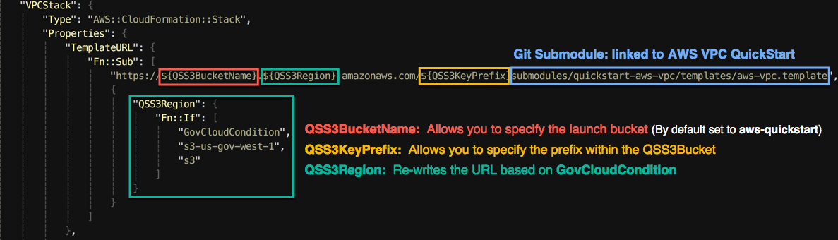
Portability

Slide 9
How are Quick Starts Maintained?

Slide 10
Maintenance Structure
All Quick Starts are opensource projects that are maintained by the Quick Start Community (AWS/Partner/End User)
Quick Start Community

Slide 11
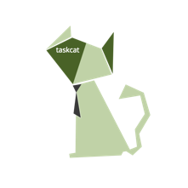
Quick Start automated workflow
All changes to Quick Starts are validated by our CI/CD System
Stage 1
1
2
3
pull request
us-east-1
+
=
us-west-1
+
ap-northeast-1
git commit
develop
master
eu-west-2
git merge
Changes Enter the code base via the develop branch
Quick Start CI
Stage 2
4
+
/quickstart-name/assets
s3://aws-quickstart
QuickStart CI

Slide 12
Developing with TaskCat

Slide 13
TaskCat
What is TaskCat?
TaskCat is an opensource tool written in Python. It’s developed and maintained the Quick Start community
TaskCat also powers the Quick Start CI System
Every change that is published to the master branch of a Quick Start runs through TaskCat
What can TaskCat do?
Stages code s3 for testing (1 or many regions)
Uses input file to pass inputs parameters to stack create
Uses runtime-injection to dynamically generate stack inputs
Collect logs from the cfn stack (including nested stacks)
Cleans up stacks
Generates test reports for every requested test region
More details to come..

Slide 14
Consistency during development
Invalid user input can lead to elongated development time
TaskCat input files are a good way to achieve this
(allow for consistent stack creation during debugging)
Manually entering inputs into the console can lead to user induced error
X

Slide 15
Features of TaskCat

Slide 16
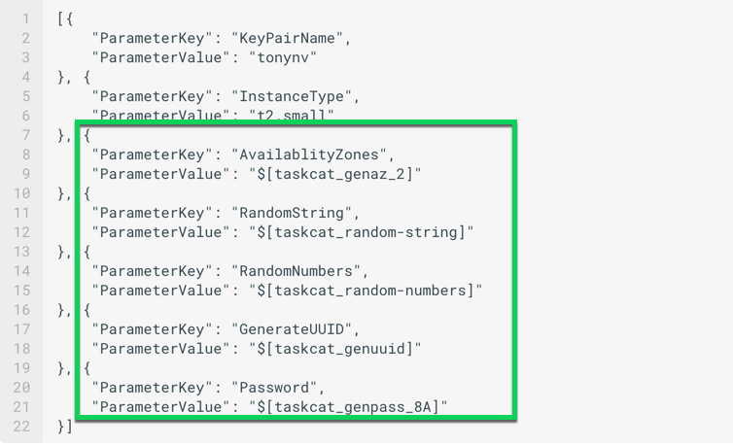
Runtime-injection
TaskCat input file and runtime-injection
Taskcat input file is a json object containing
Parameter Keys and Values
(Note: you can json inputs directly with CloudFormation cli)
The example here shows an input file for a stack that requires seven parameters:
KeyPair
InstanceType
AvailablityZones
RandomString
RandomNumbers
GenerateUUID
Password
The ParameterValues in the green box will get evaluated by taskcat and replaced before stack_create is called with environmentally specific (region) values

Slide 17
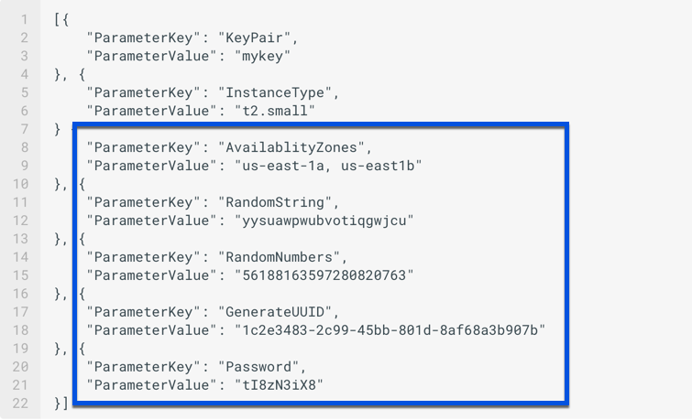
Runtime-injection
TaskCat input file and runtime-injection
Taskcat input file is a json object containing
Parameter Keys and Values
More info: https://aws-quickstart.github.io/taskcat/#more-information-on-taskcat-runtime-injection
KeyPair
InstanceType
AvailablityZones
RandomString
RandomNumbers
GenerateUUID
Password
The ParameterValues in blue box are evaluated and replaced as requested
Note: All Parameters that don’t have default values will require an entry in the input file

Slide 18
Setting up TaskCat deployments

Slide 19
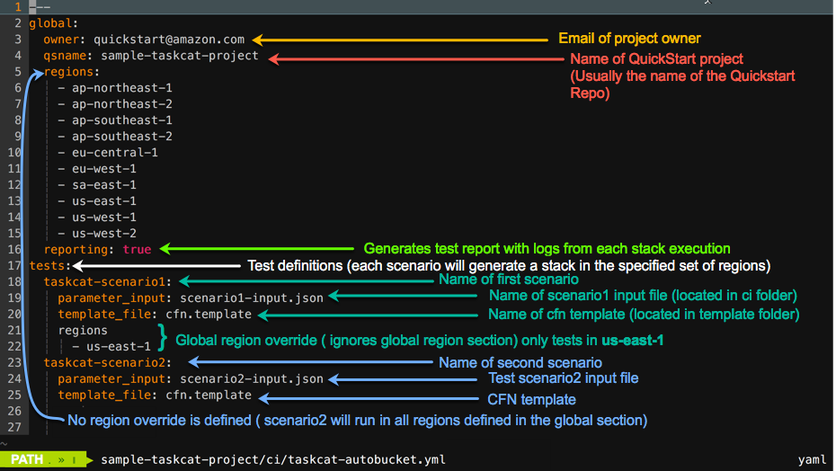
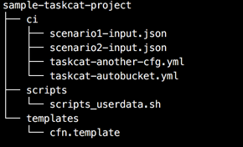
Taskcat config file
All Quick Starts have a taskcat config file in the ci folder.
Directory structure of a simple project

Slide 20
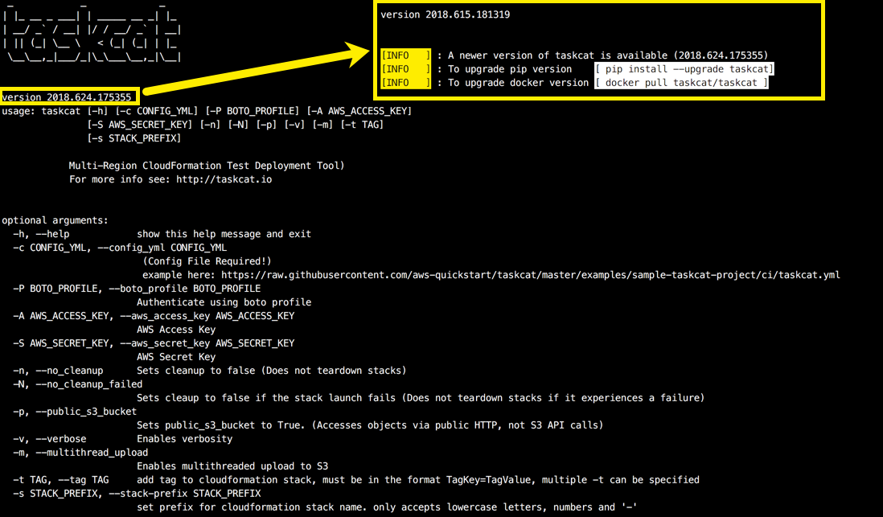
Taskcat (Screen Shots)
Running taskcat with no argument will print the help/usage menu
# taskcat
If there is a new version of taskcat available additional messages will be displayed informing you on how to upgrade to the latest version!

Slide 21
Running TaskCat

Slide 22
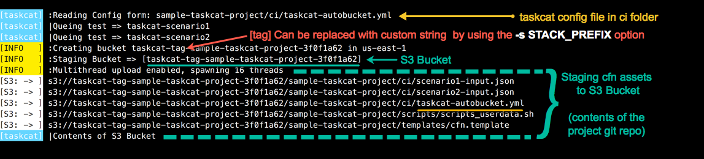
Taskcat Run (Screen Shots)
Command to start a taskcat run:
# taskcat -c sample-taskcat-project/ci/taskcat-autobucket.yml -p -m
-p make the autogenerated bucket public
-m use multiple threads when uploading to s3

Slide 23
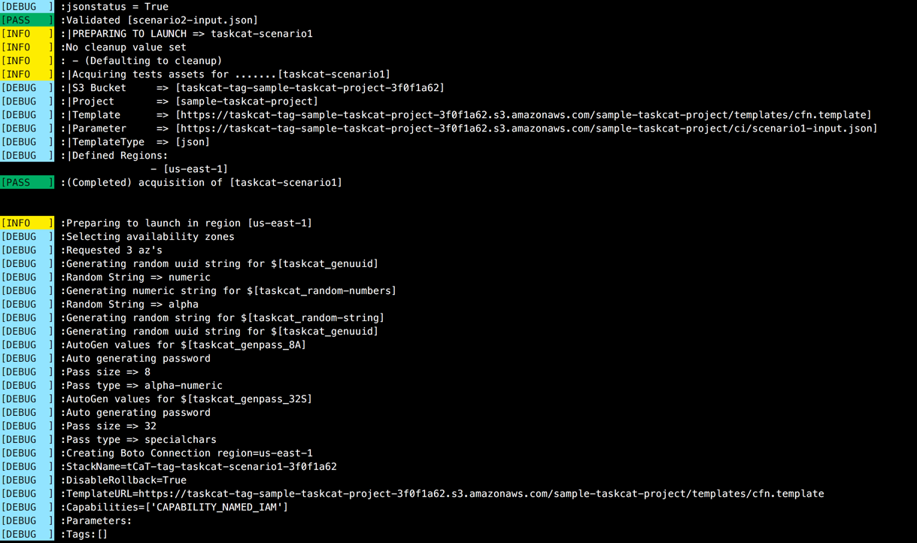
Taskcat Run (Screen Shots)
Validate template syntax using CloudFormation API and
Validates template Syntax via CFN API
Preparing launch of senario1

Slide 24
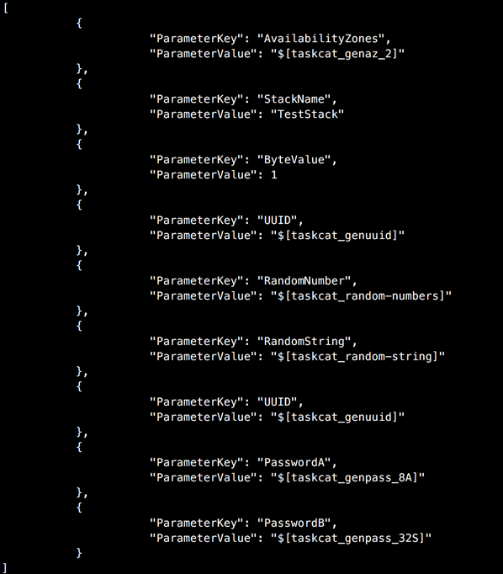
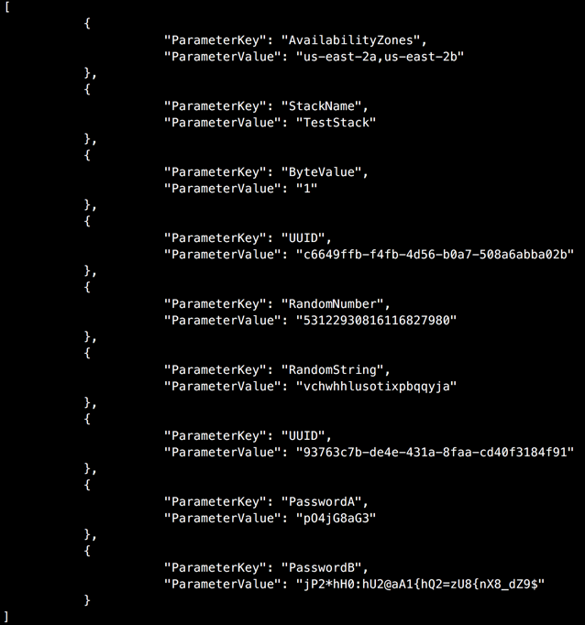
Taskcat Run (Screen Shots)
Generate inputs per scenario
Input file (left)
Evaluated values (right)

Slide 25
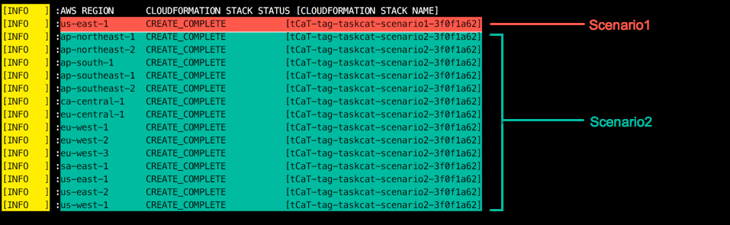
Taskcat Run (Screen Shots)
Taskcat execution

Slide 26
Installing Taskcat
Option1 : OSX with docker
Option2 : Linux Workstation or VM
Option3 : Launch ec2 instance via Cloudfromation
Option3 is recommended for users that do not have docker experience
or do not have an OSX or Linux workstation available
https://aws-quickstart.github.io/taskcat/#installing-taskcat

Slide 27
Installing taskcat
Install taskcat using pip
- Add python bin to your taskcat environment
Example MacOS = (Linux distros see here)
taskcat requires python3
Note: your python version may be python 2.7
Check your python version
– python –V
if you are using python3 the output should reflect Python 3.6.5
Install using pip3 install taskcat –user
Note: note –user will install taskcat executables in your home directory
Add Python bin to your path
export PATH=$PATH:~/Library/Python/3.6/bin
Module (3) Testing with taskcat

